Slide 1
Operating Systems
Dr. Deepak Dembla

Slide 2
Basic Memory Management

Slide 3
Objectives
Static and dynamic memory allocation
Basic concepts for memory management: logical and physical addresses, swapping, relocation, protection and sharing, fragmentation
Fixed and variable memory partitioning
Contiguous memory allocation
Memory partition selection techniques: First-fit, best-fit, worst fit
Non-contiguous memory allocation
Paging concept
Paging implementation with associative cache memory
Page table and its structures
Segmentation concept
Hardware requirements for segmentation

Slide 4
Static and dynamic allocation
In static allocation, the allocation is done before the execution of the process
If the memory allocation is deferred till the process starts executing, it is known as dynamic allocation. It means the process is loaded in memory initially with all memory references in relative form

Slide 5
Logical and physical addresses
The processor at compile time generates some addresses known as logical addresses. The set of all logical addresses generated by the compilation of the process is known as logical address space.
Logical addresses need to be converted into absolute addresses at the time of execution of the process. These absolute addresses are known as physical addresses. The set of physical addresses generated corresponding to all logical addresses during process execution is known as physical address space

Slide 6
Swapping
The action of taking out a process from the memory is called swap-out and the processes are known as swapped-out processes.
When the swapped-out process is brought again in the memory, it is called as swap-in. The separate space in hard disk known as swap space is reserved for the swapped-out processes.

Slide 7
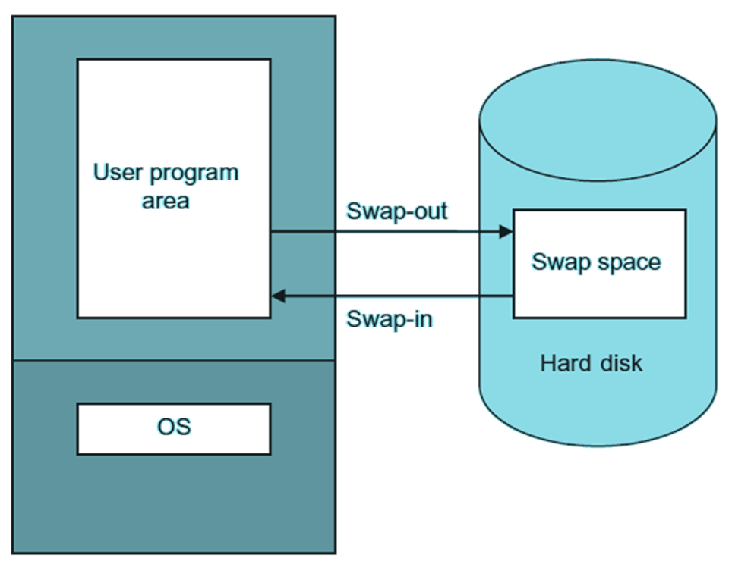
Swapping

Slide 8
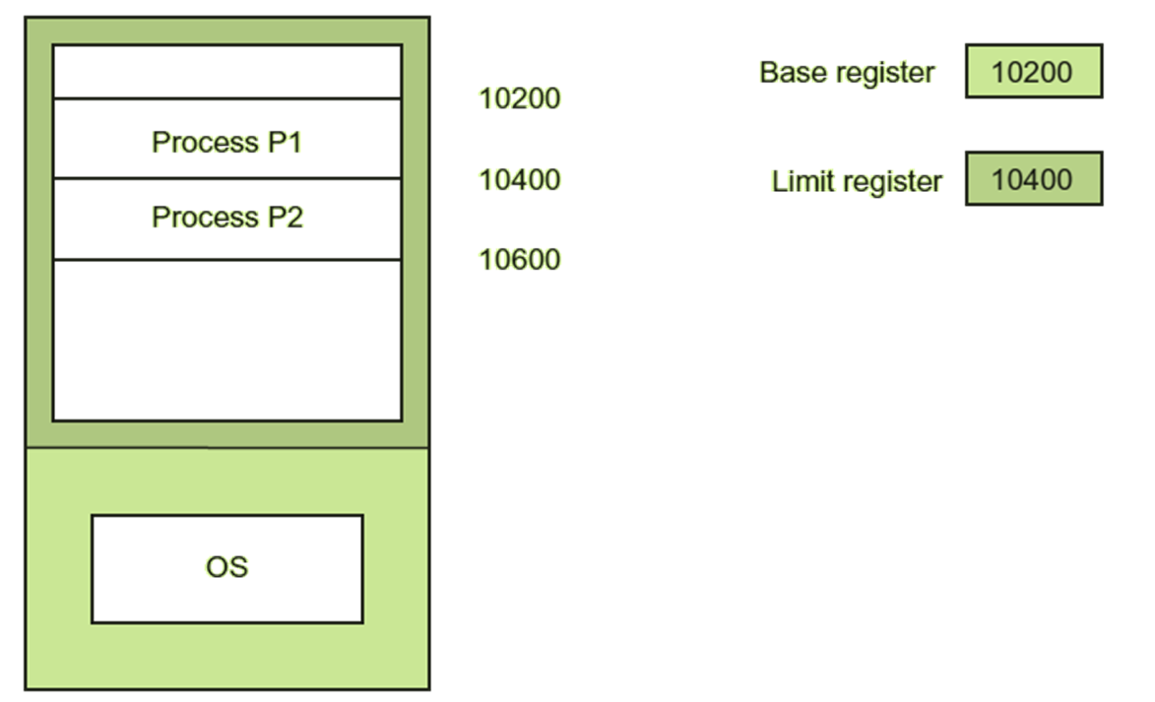
Relocation with base and limit register

Slide 9
Contiguous memory allocation
The contiguous allocation method was implemented by partitioning the memory into various regions.
The memory partition which is free to allocate is known as a hole. Thus an appropriate hole is searched for allocating memory to a process.

Slide 10
Contiguous allocation with fixed partitioning
Fixed partitioning is the method of partitioning the memory at the time of system generation.
The partition size can be of fixed as well as variable but once fixed cannot be changed.

Slide 11
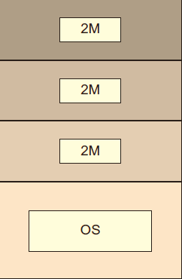
Fixed equal sized partitioning based contiguous memory allocation

Slide 12
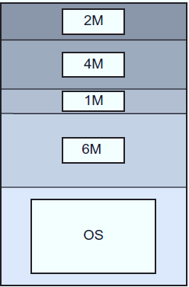
Fixed unequal sized partitioning based contiguous memory allocation

Slide 13
Contiguous allocation with dynamic/variable partitioning
Instead of having static partitions in the memory the memory partition will be allocated to a process dynamically.
As the processes dynamically occupy and release the memory, a time is reached when there are small holes generated in the memory partitions. These memory partitions at a certain time cause the external fragmentation.

Slide 14
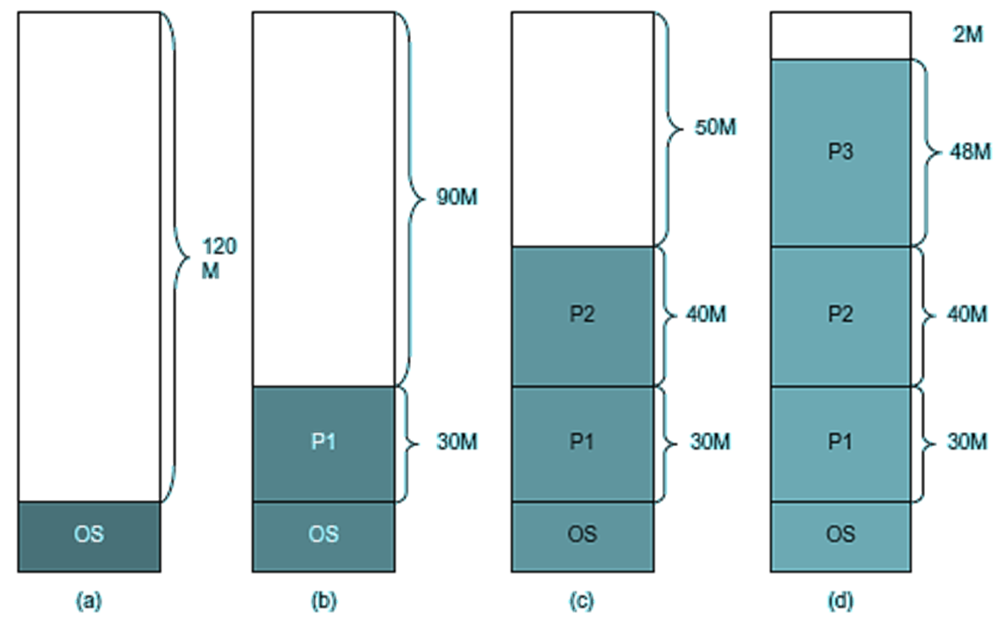
Variable Partitioning

Slide 15
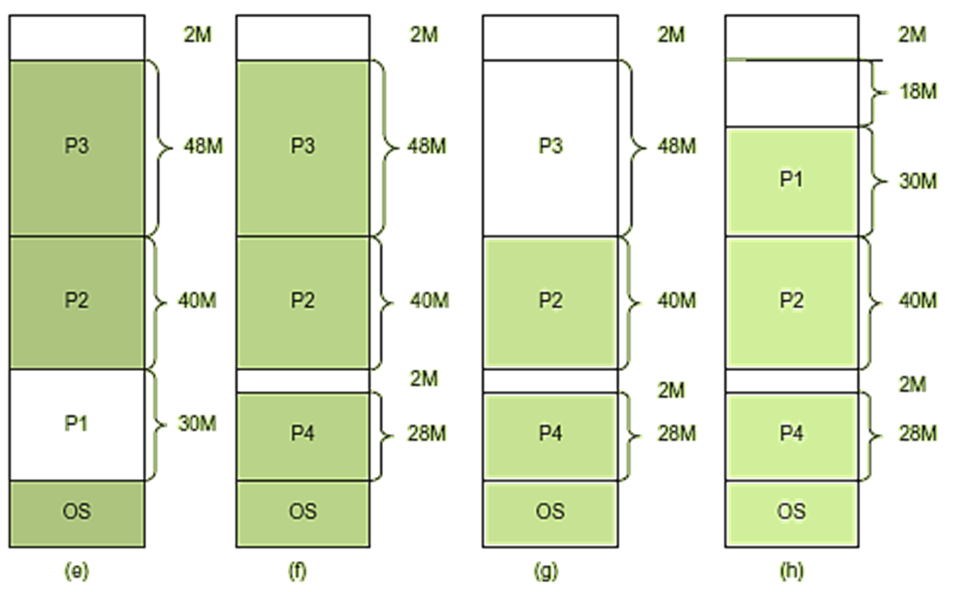
Variable Partitioning

Slide 16
Compaction
Compaction is the solution for memory wastage occurred in dynamic partitioning. The operating system observes the number of holes in the memory and compacts them after a period so that a contiguous memory can be allocated for a new process.

Slide 17
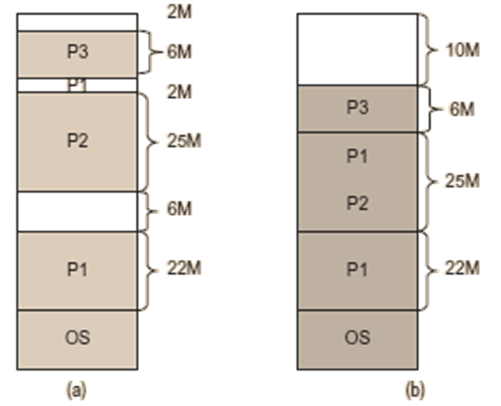
Compaction

Slide 18
Memory partition selection techniques
Memory allocation techniques are the algorithms that satisfy the memory needs of a process of size n out of the list of available free holes thereby known as partition selection algorithms.
First-Fit Allocation
searches the list of free holes and allocates the first hole in the list that is big enough to accommodate the required process

Slide 19
Memory partition selection techniques
Best-Fit Allocation
searches the list by comparing the memory size of the process to be allocated with the free hole in the list.
Worst-Fit Allocation
searches the list by comparing the memory size of the process to be allocated with the free hole in the list and the hole that will waste maximum memory

Slide 20
Buddy system
There are some drawbacks in both types of memory partitioning as discussed above. A technique that may be the compromise of both was devised known as Buddy system.

Slide 21
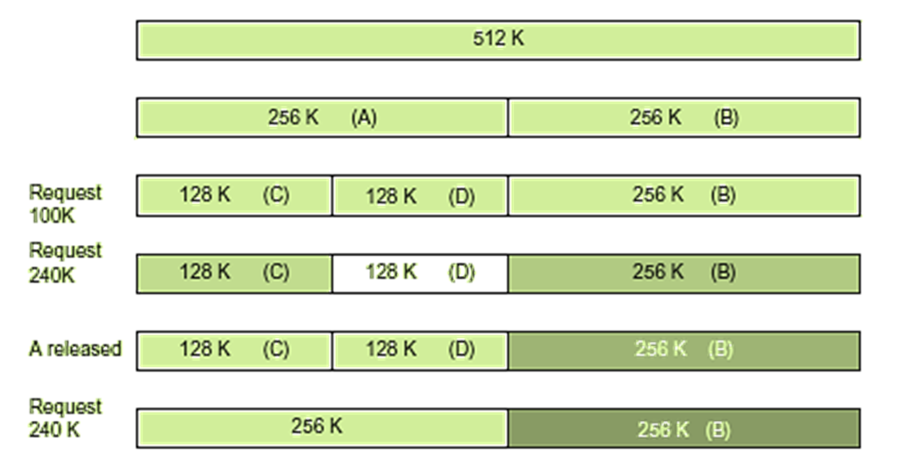
Buddy system

Slide 22
Non-contiguous memory allocation
Contiguous allocation method either in memory or in backing store wastes much of the memory. It leads not to have contiguous allocation but non-contiguous method, i.e. instead of having sufficient contiguous memory space it should be possible to allocate the space in memory wherever the holes are available. The holes need not to be contiguous.

Slide 23
Paging concept
Memory is equal-sized partitioned
Partitions are known as frames
The logical memory of a process is also divided into small fixed-size chunks or blocks of the same size as of frames. These chunks of processes are called pages of the process.
The hard disk is also divided into the blocks which are of same size as frames.
Thus, paging is a logical concept that divides the logical address space of a process into fixed sized partitions known as pages and is implemented in physical memory through the frames.
Instead of a base register for every page, the start addresses of pages are stored in the form of a table known as page table.

Slide 24
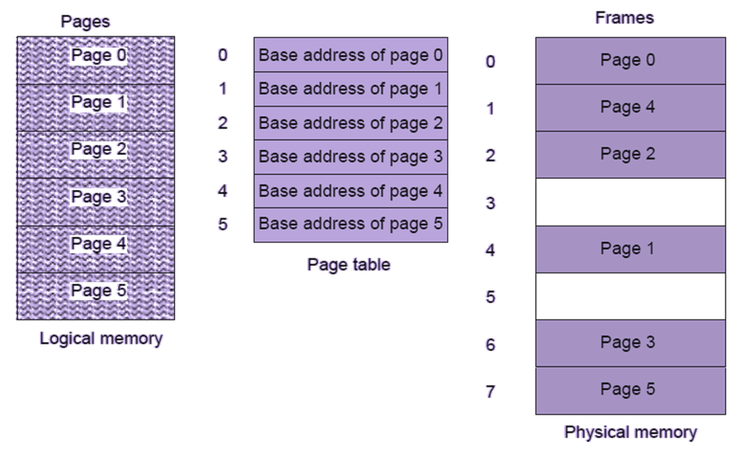
Paging concept

Slide 25
Paging concept
Paging generates the logical address in the form:
(Page number p, Offset d)
The logical address is converted into physical address by the memory management unit. page table is stored in memory only in contemporary operating systems. The hardware support needed in this case is to have a register just like the base register so that the page table address can be stored. This base register is now known as page table base register (PTBR).
some of the page table entries are cached in a high speed cache memory. A high speed associative cache memory known as translation look aside buffer (TLB) is used for this purpose.

Slide 26
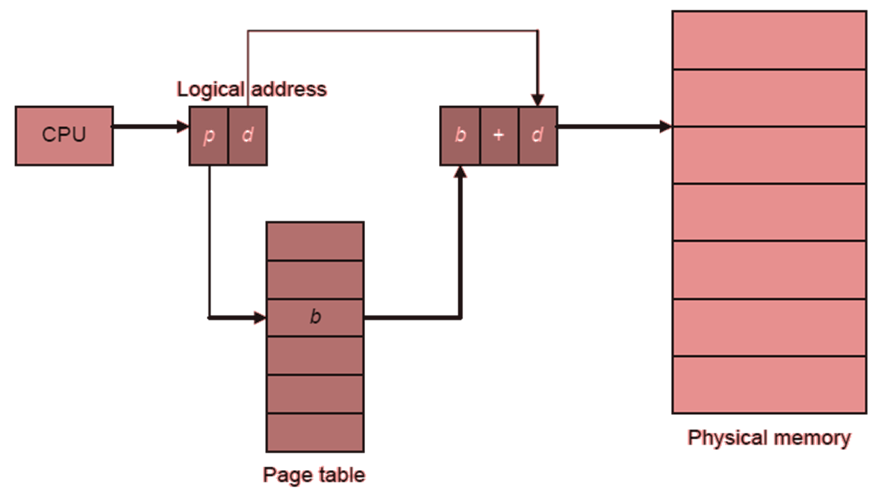
Address translation in paging

Slide 27
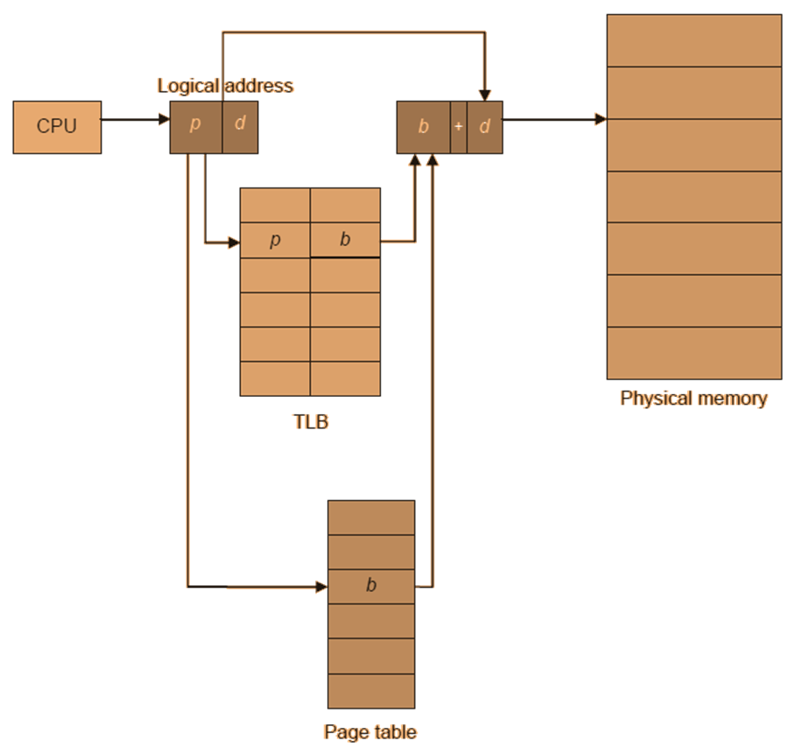
Paging implementation with TLB

Slide 28
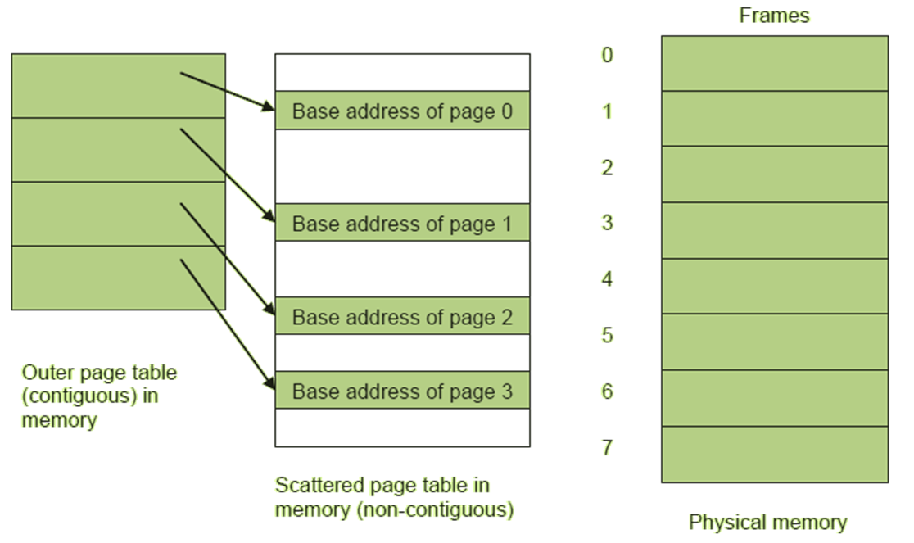
Two-level page table structure

Slide 29
Inverted page table structure
The inverted page table is indexed by the page frame number of the physical memory rather than virtual page number. The logical address in this page table structure is generated as process id, page number and displacement: (pid, p, d)

Slide 30
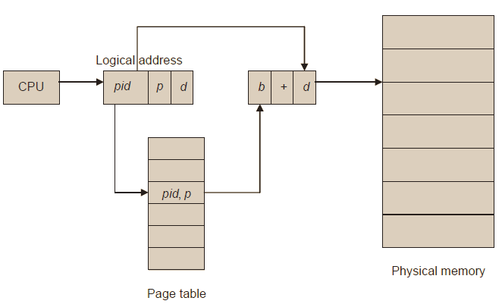
Address translation in paging using inverted page table

Slide 31
Hashed page table structure
Searching the inverted page table may adversely affect the performance of paging in the system. Therefore, hashing is used to speed up the page table lookup. An appropriate hash function is used and applied on the page number of the virtual address to locate the page table entry.

Slide 32
Segmentation
The segments are logical divisions of a program and are therefore may be of different sizes whereas pages in paging concept are physical divisions of program and are of equal sized.

